Slide 1
Example Project
Presentation
Dan Bennett
DSCI 101
Section 007

Slide 2
A Quick Example
Title Slide
Introduce your topic
Describe your dataset
Describe your data
Describe your methods
Describe how you cleaned your data
What did you discover?
Conclusions/Next Step
Make sure you look at the assignment page!

Slide 3
2014 NFL Ticket Prices
Division Games
Dan Bennett
DSCI 101
Fall 2018

Slide 4
Ticket Prices in the NFL
Is there any factor that can be identified as contributing to ticket prices?
Possible factors investigated
  Conference
  Region
  Day of Game
  Month of Game

Slide 5
My Data
NFL Ticket Prices from fivethirtyeight’s github account
Originally obtained from StubHub.com
Information on 96 games
  2014 Divisional games
  Through Dec 16
A CSV file
8.25 KB

Slide 6
The Dataset
Three fields
  Event: a text filed
    Baltimore Ravens at Pittsburgh Steelers Tickets on 02-Nov-2014 (9037819)
  The Division: a text field
    AFC/NFC
    North, South, East, West
    AFC North
  The Average Ticket Price in Dollars: an integer
    202
  An Entire Record:
    Baltimore Ravens at Pittsburgh Steelers Tickets on 02-Nov-2014 (9037819),AFC North,202

Slide 7
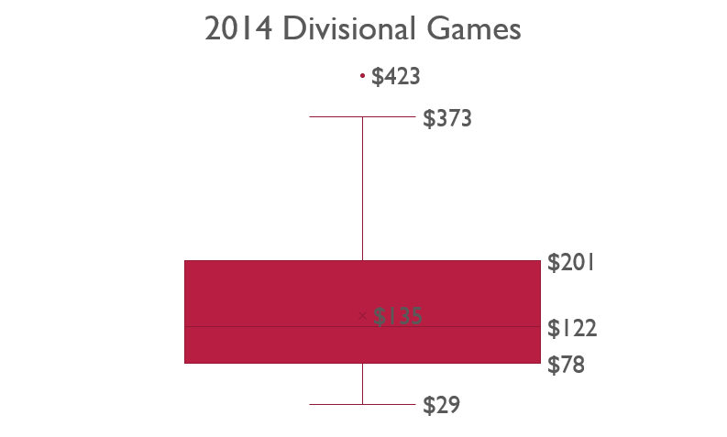
The Average Ticket Price
Maximum Price:
  $423
  Packers vs Bears
Minimum Price
  $29
  Cardinals at Rams

Slide 8
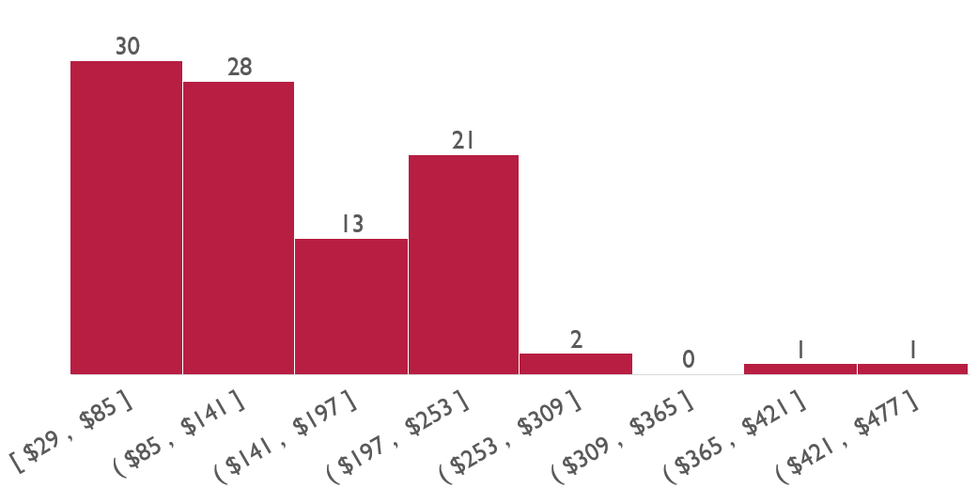
Average Ticket Price
Most games were less than $200
Two games were very expensive

Slide 9
Meta-Slide
Describe all of the native data fields that you have used.
If your data set is large
  Skip the ones you did not use.

Slide 10
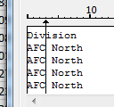
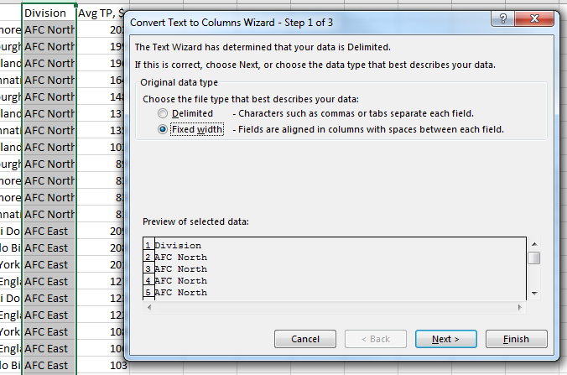
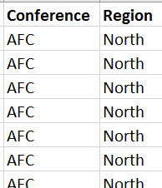
Derived Fields
From the Division
  Created a Conference (AFC/NFC)
  Created a Region (North, South, East, West)
This was done with Text to Columns
  Fixed Width (3 for conference)

Slide 11
The Event Field
This was a challenge
  Used multiple text functions to split the field
Derived Values
  Home Team
  Away Team
  Month Name
  Day Name
Away Team | Home Team | Month Name | Day Name
Green Bay Packers | Chicago Bears | September | Sunday
San Francisco 49ers | Seattle Seahawks | December | Sunday
Chicago Bears | Green Bay Packers | November | Sunday
Seattle Seahawks | San Francisco 49ers | November | Thursday
San Diego Chargers | Denver Broncos | October | Thursday
Dallas Cowboys | Philadelphia Eagles | December | Sunday

Slide 12

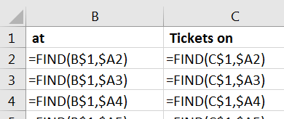

Home and Away Team
Split the Event field on “at” and “Tickets on”
Green Bay Packers at Chicago Bears Tickets on 28-Sep-2014 (9037834)
  Computed the position of each
  Formed provided indexes for text “left” and “mid” operations

Slide 13
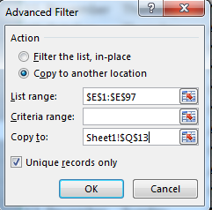

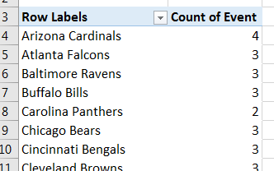
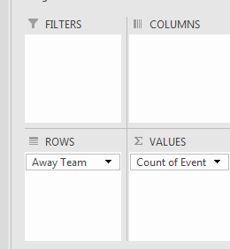
Home and Away Team
There were 32 unique teams
  Advanced data filter on the away team column
  counta of the resulting field
Each team had 3-4 away games
  Pivot Table!
Arizona Cardinals | 4
Atlanta Falcons | 3
Baltimore Ravens | 3
Buffalo Bills | 3
Carolina Panthers | 2
Chicago Bears | 3

Slide 14
Meta-Slide
Summarize ALL derived data
  Don’t derive it if you don’t use it.
  Or delete it.
Methods:
  Notice I am mixing my methods with my other data.
  This is fine, just as long as there is a presentation of methods.
  You probably don’t want to present ALL of your methods, just anything interesting.

Slide 15
Problems With Data
There were no problems with the data
  All fields were present
  All data appeared to be clean
Meta- Point
  You should do this at least.

Slide 16
Discoveries
It was least expensive to attend a game in the South!
  Pivot Chart!

Slide 17
FUTURE work
Try to get data for all games
Try to get data for
  Ticket prices and tickets sold for each game

Slide 18
Questions or Comments?
Thank you for your time!

